Slide 1
Detecting Credit-card Fraud
Sparsh Chandra
Dishank Sanklecha
Komal Swain
Aishwarya Tikare

Slide 2
Problem Statement
The main aim of the project is to detect the fraudulent transaction in credit card
It includes modeling past transaction that turned out to be fraud
The new model is used to detect, if the new transaction is fraud or not
It will minimize the fraud transaction while 100% detecting the fraudulent transaction

Slide 3
Sample Data set
https://drive.google.com/file/d/1CTAlmlREFRaEN3NoHHitewpqAtWS5cVQ/view
Data set consist of mix data with total 284,807 observations
28 numerical value, namely V1 to V28
There is no missing value in dataset
We will be importing the dataset, and performing exploration, data manipulation followed by data modelling

Slide 4
Algorithm/ Methodology
There are various algorithm that will come into place, namely
Decision tree
Logistic regression
Artificial Neural Network
Gradient boosting classifier

Slide 5
Software
To execute the specified task, we will be using R programming language

Slide 6
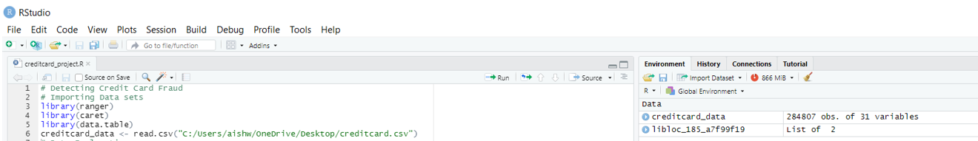
Importing dataset that contain the transactions made by credit card
We can see that the data set has 284807 observations of 31 variables

Slide 7
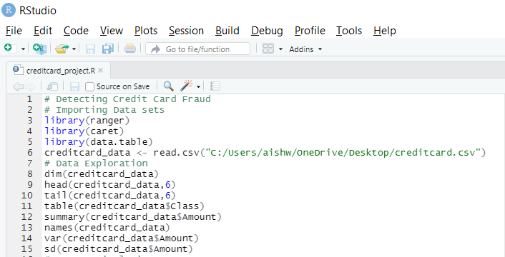
Data Exploration
We are looking at the data in the credit card data frame in this section of the fraud detection-machine learning project.
The credit card data will be displayed using the head() and tail() functions.
After that, we will look at the other elements of this data frame
Here is the code for data exploration..

Slide 8
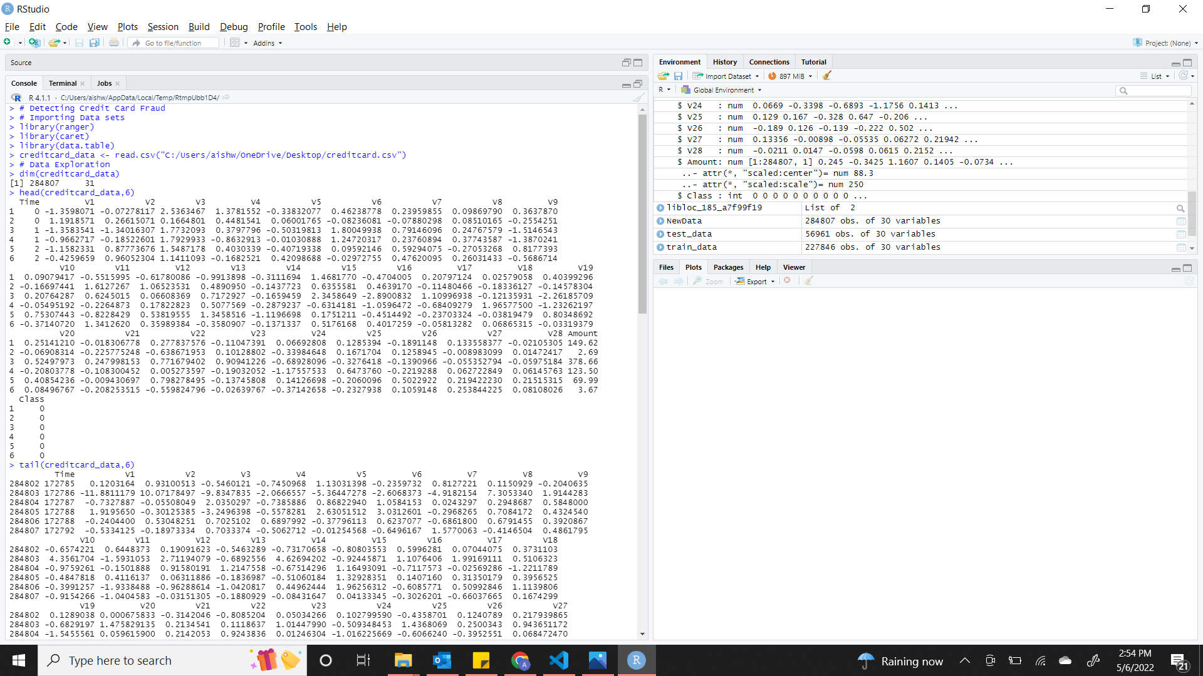

Slide 9
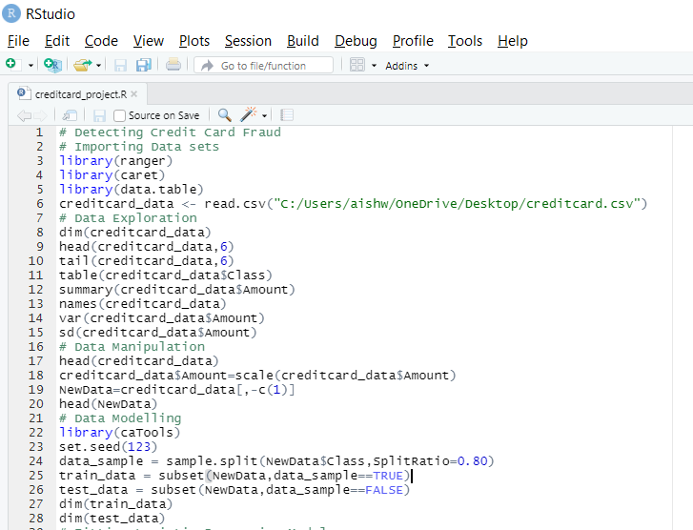
Data Manipulation
We use the scale() function to scale our data in this phase of the R data science project. This will be applied to the credit card data amount's amount component
Feature standardization is another term for scaling. The data is organized according to a given range with the help of scaling
As a result, our dataset contains no extreme values that could cause our model to malfunction
This is the code for data manipulation

Slide 10
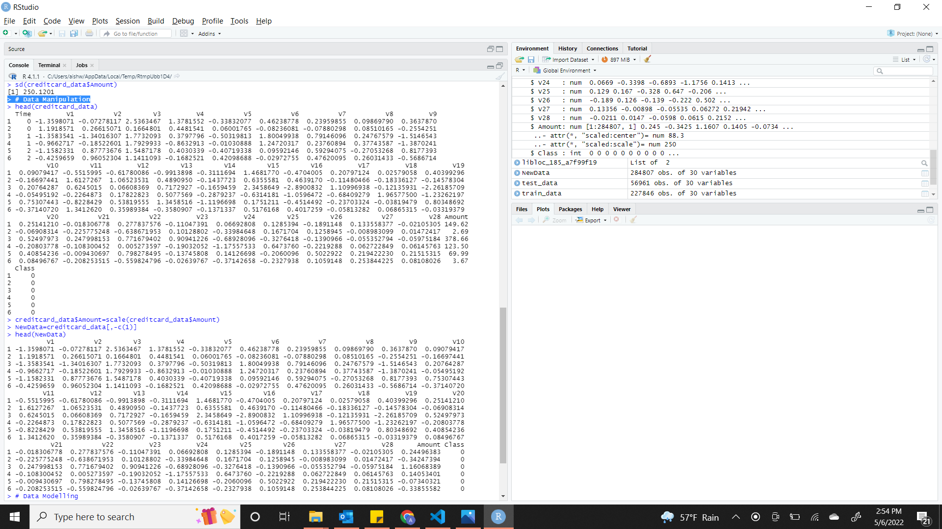

Slide 11
Data Modelling
We will split our dataset into training and test sets with a split ratio of 0.80 after we have standardized our entire dataset
This indicates that the train data will account for 80% of our data, while the test data will account for 20%
The dimensions will be found using the dim() function

Slide 12
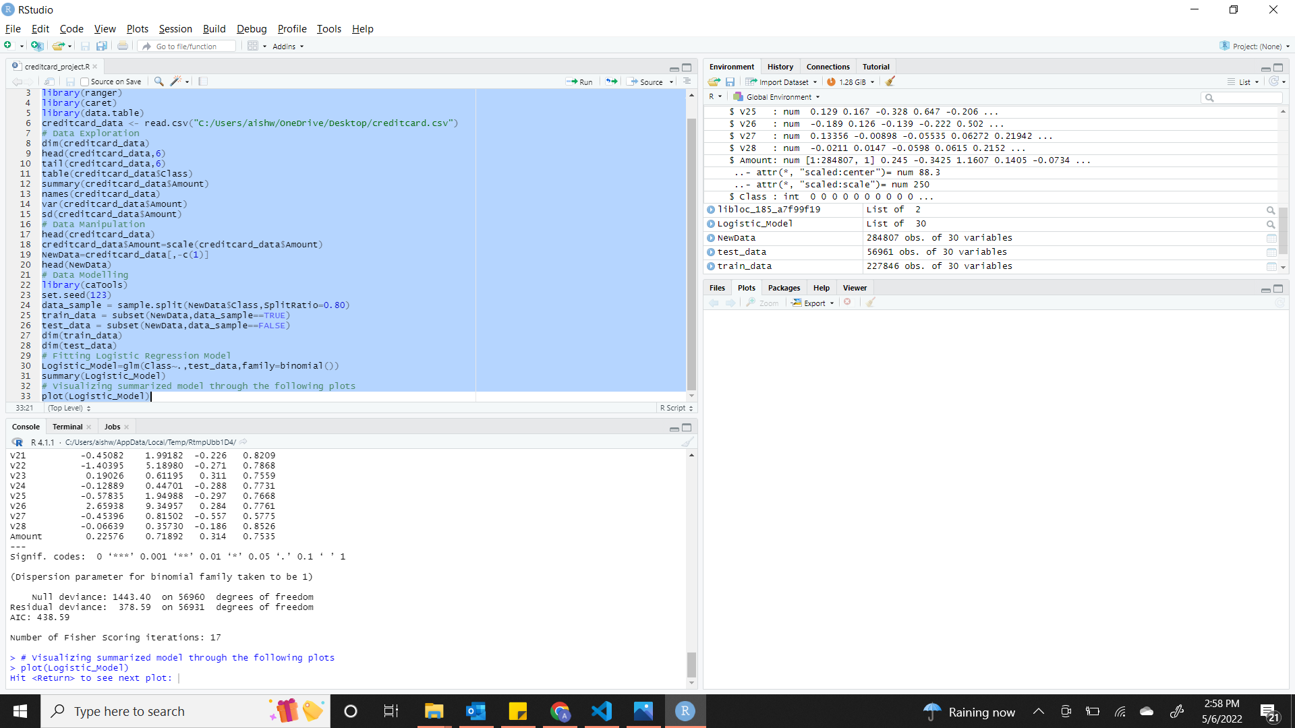
Data Modelling

Slide 13
Fitting Logistic Regression Model
We will fit our first model in this phase of the credit card fraud detection project
We will get started with logistic regression
A logistic regression is used to model the probability of a class's outcome, such as pass/fail, positive/negative, and fraud/not fraud in our project
We use the following procedure to apply this model to our data

Slide 14
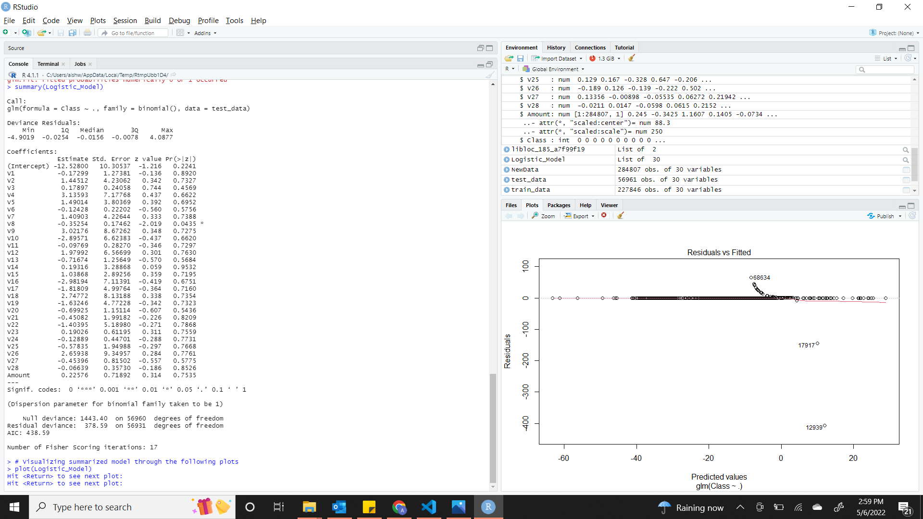
Fitting Logistic Regression Model

Slide 15
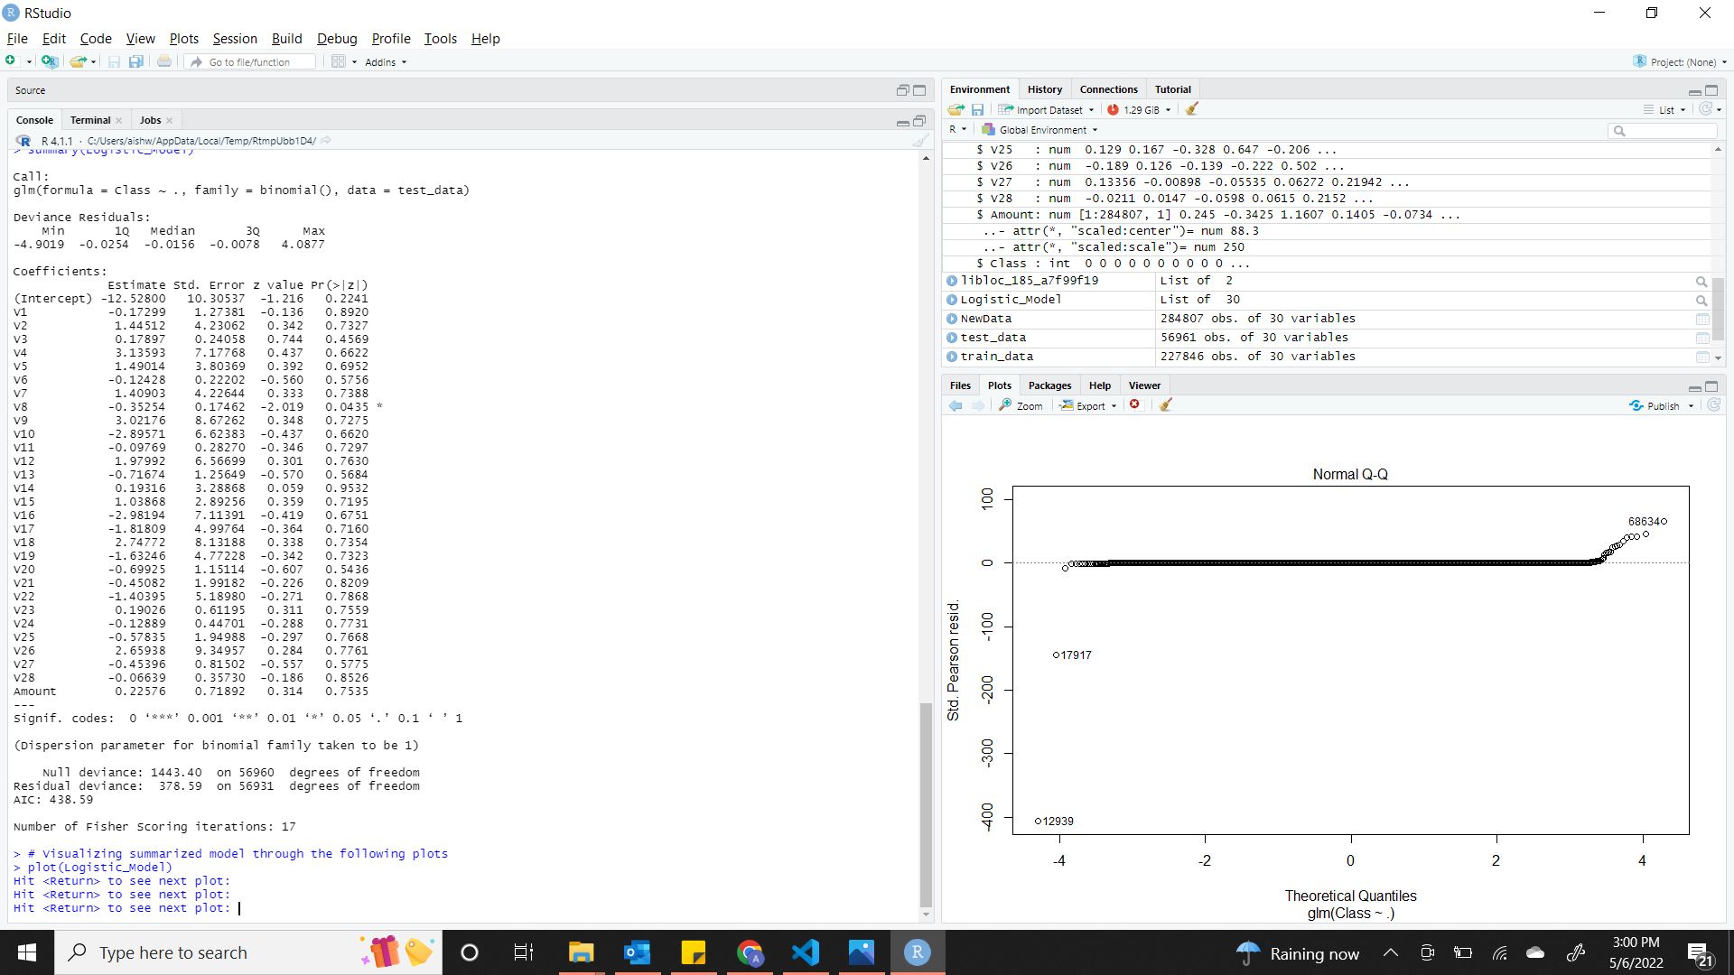
Fitting Logistic Regression Model

Slide 16
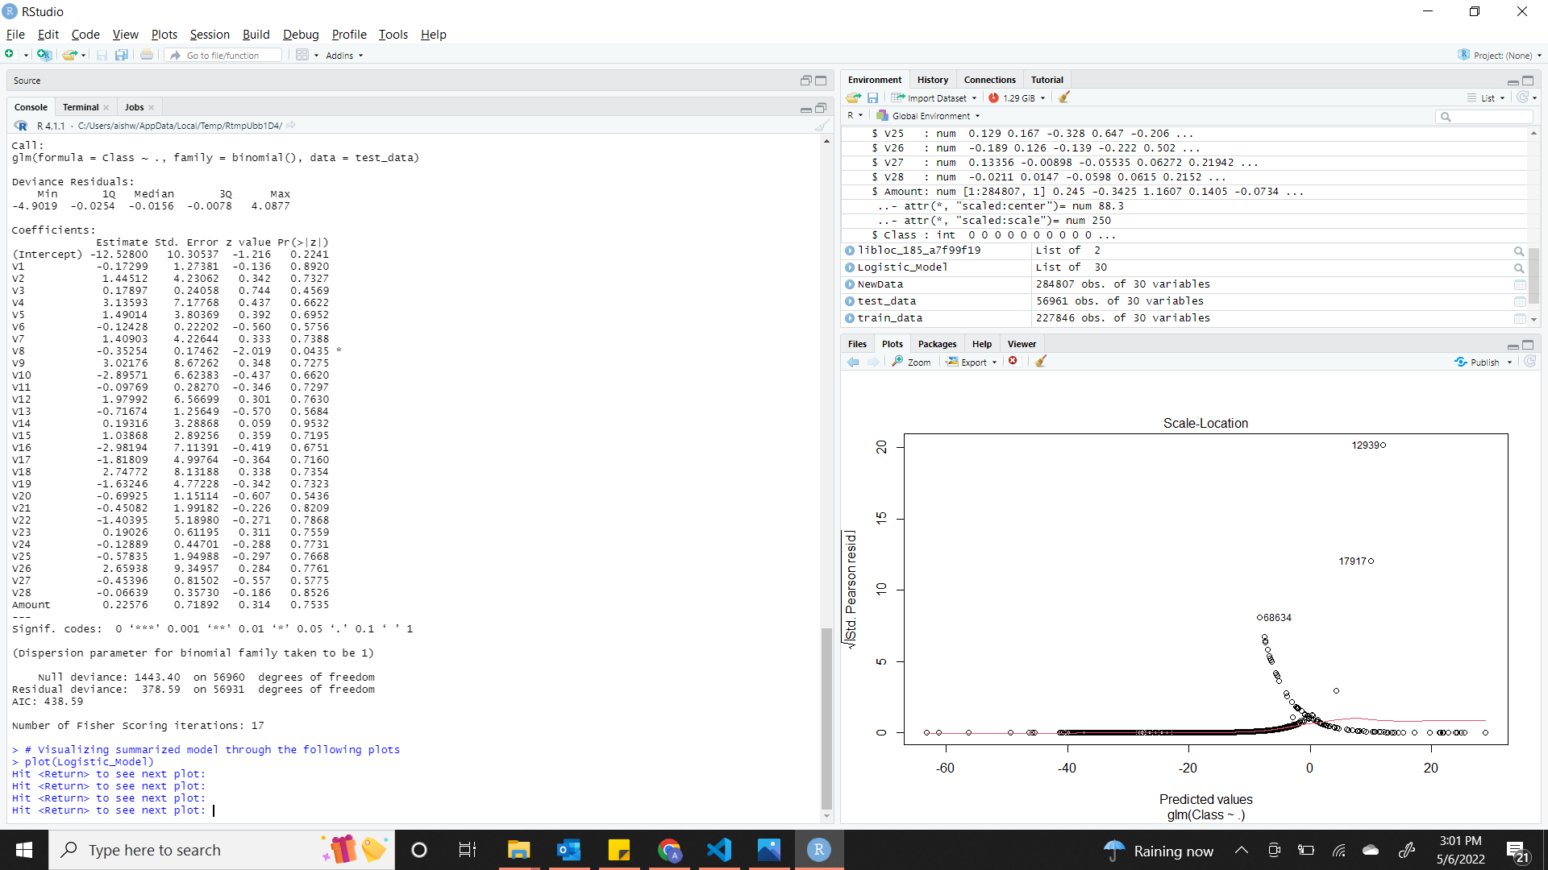
Fitting Logistic Regression Model

Slide 17
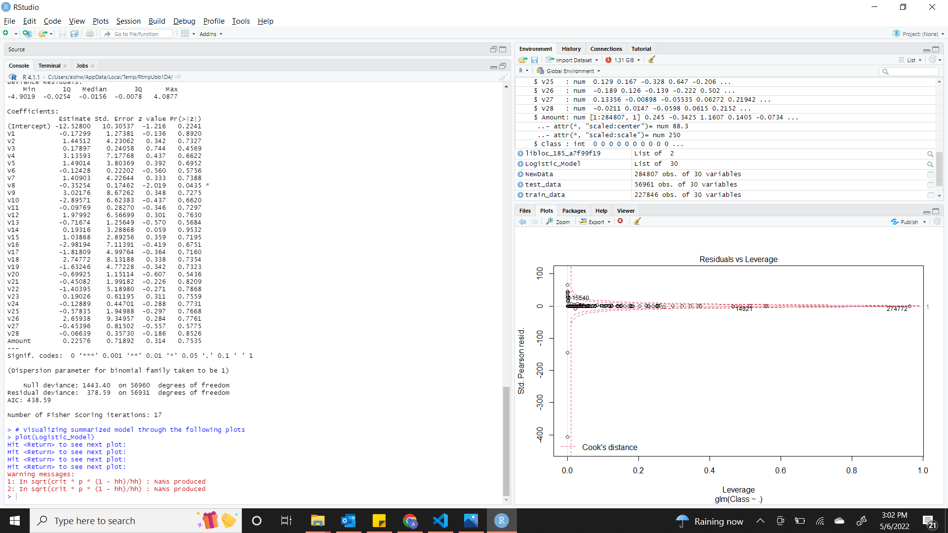
Fitting Logistic Regression Model

Slide 18
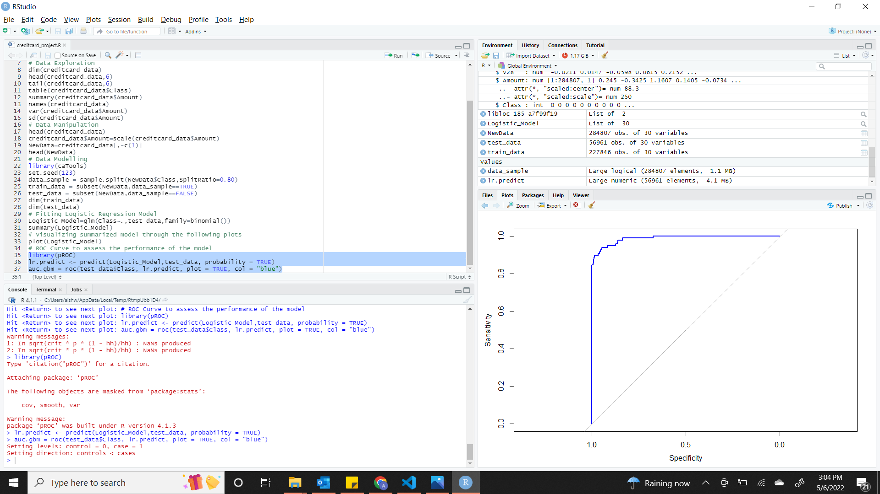
Fitting Logistic Regression Model

Slide 19
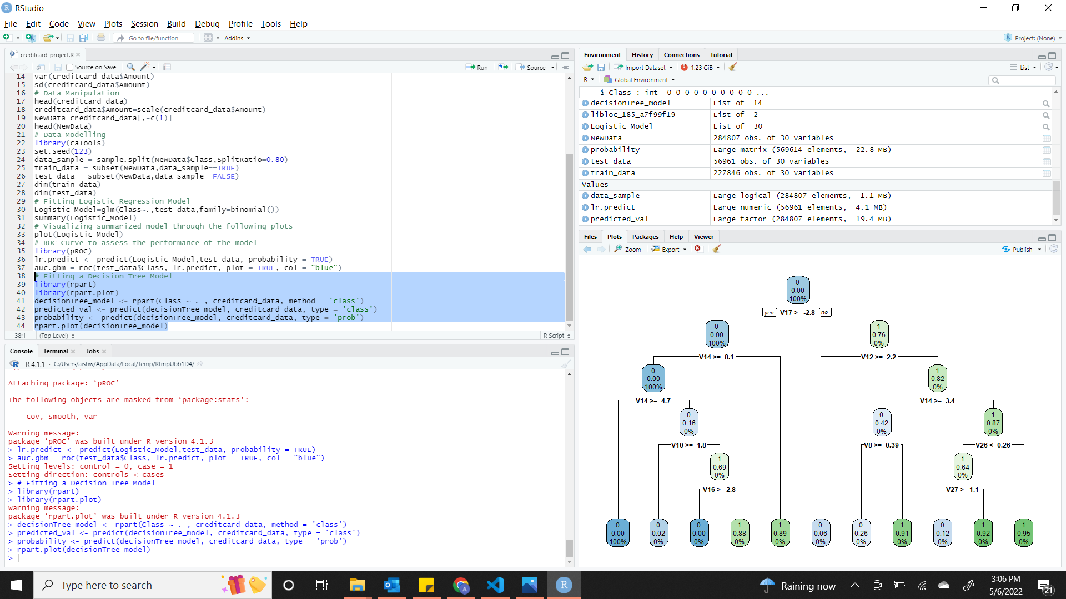
Decision tree
We will implement a decision tree algorithm in this part
To plot the outcomes of a decision, use Decision Trees, these outcomes are essentially a result that allows us to determine which class the object belongs too
Our decision tree model will now be implemented and plotted using the rpart.plot() function
The recursive splitting will be used to plot the decision tree particularly.

Slide 20
Artificial Neural Network
Artificial Neural Networks (ANNs) are a form of machine learning algorithm inspired by the human nervous system
The ANN models are capable of learning patterns from past data and performing classification on the input data
We import the neural net package, which will allow us to create our artificial neural networks
Then, using the plot() function, we plotted it.
In the case of Artificial Neural Networks, there is now a value range between 1 and 0
We set a threshold of 0.5, which means that values greater than 0.5 correspond to 1 and the remainder to 0

Slide 21
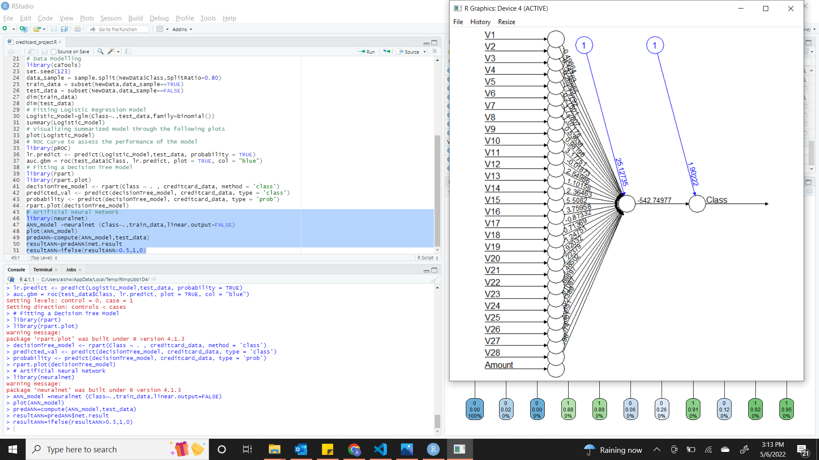
Artificial Neural Network

Slide 22
Gradient Boosting(GBM)
Gradient Boosting is a well-known machine learning approach for classification and regression problems
Several underlying ensemble models, such as weak decision trees, make up this model
These decision trees are combined to produce a powerful gradient boosting model
In our model, we use the gradient descent

Slide 23
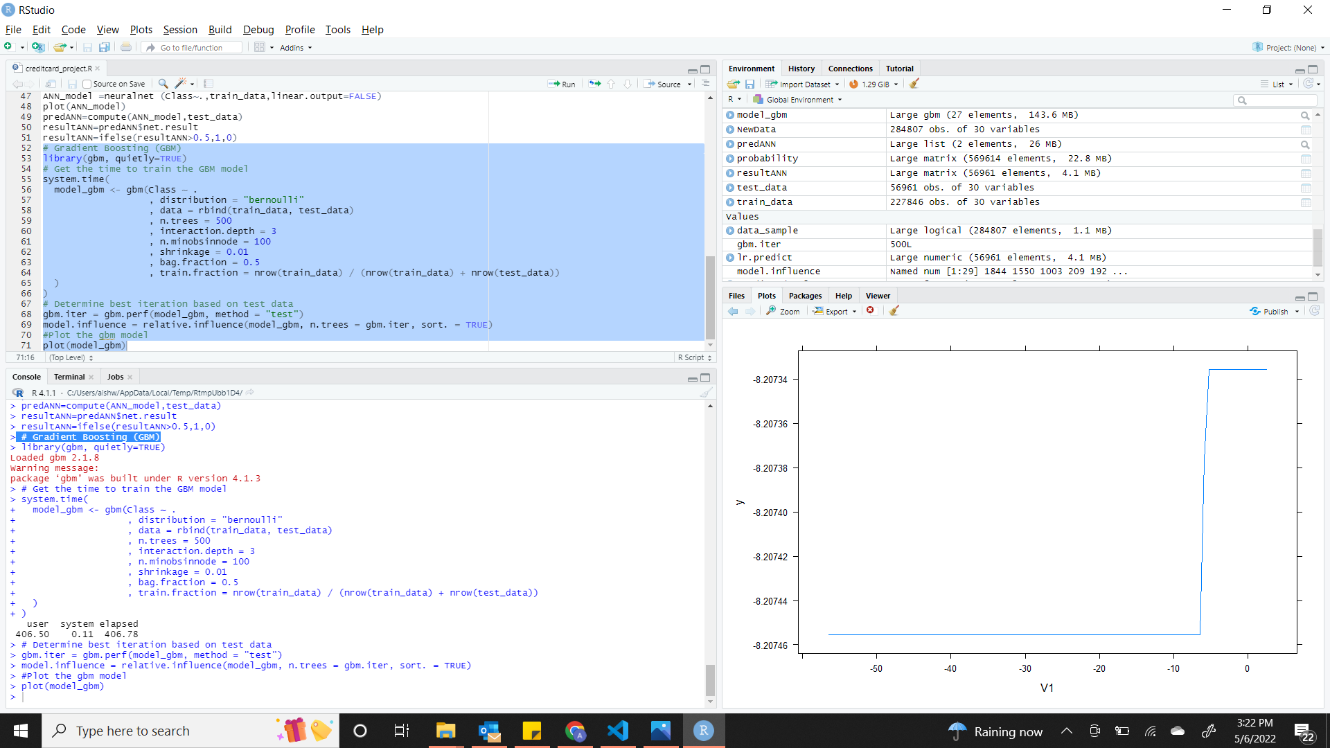
Gradient Boosting(GBM)

Slide 24
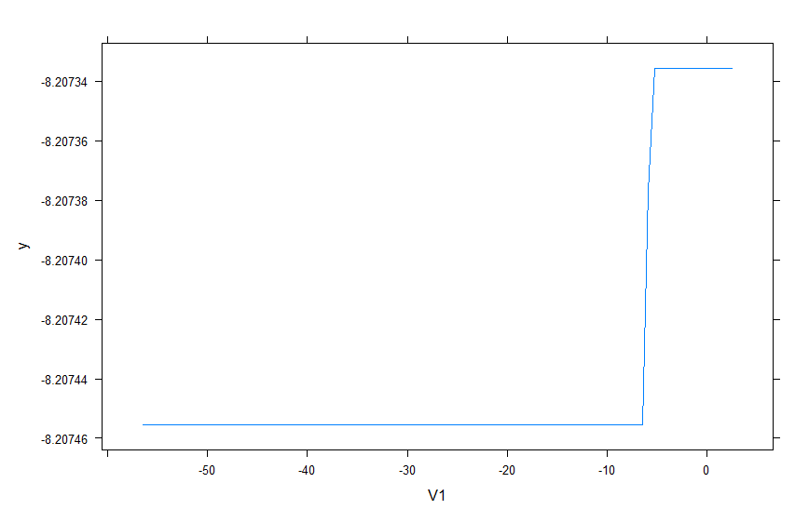
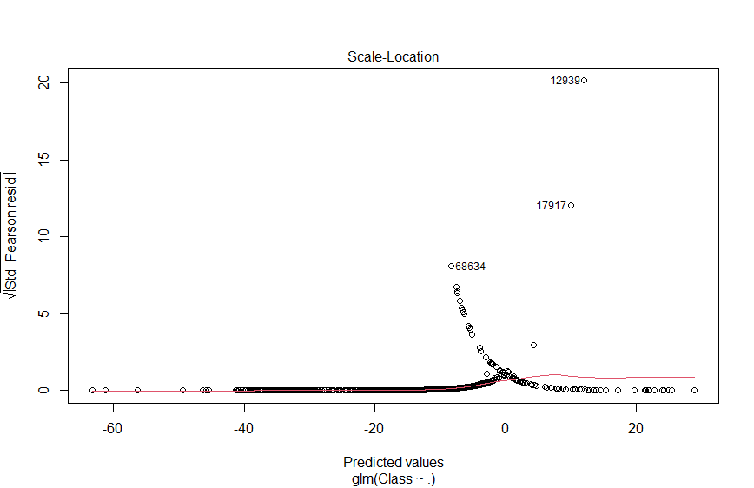
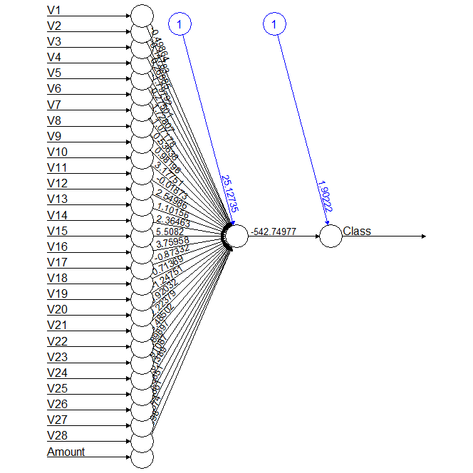
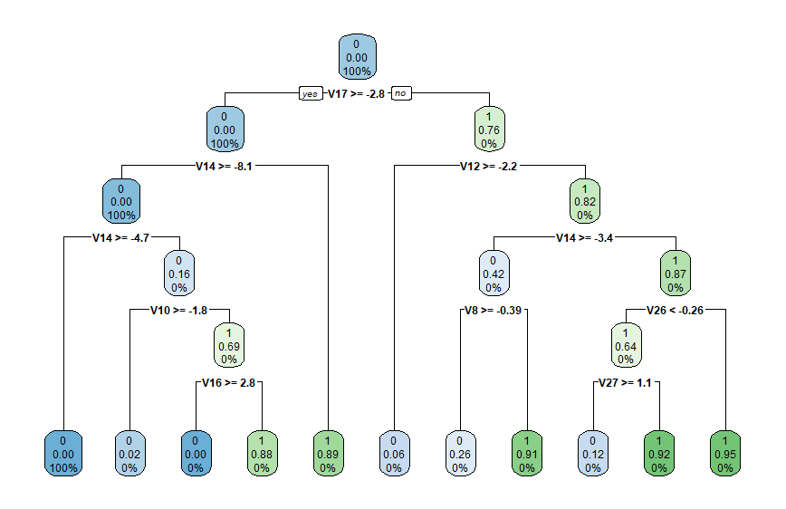
Data Visualization

Slide 25
Conclusion
We learned how to use machine learning to construct our credit card fraud detection model as part of our project
We implemented this model using several machine learning algorithms and plotted the model's performance curves
We learned how to analyze and interpret data in order to distinguish fraudulent transactions from other sorts of information

Slide 26
Thank you

